Slide 1
DEPI-GIZ1_DAT2_G1e Final Project_Group 3
The Maven Toys- Supply Chain Analysis
AbdelRahman Mostafa Taha
Alaa Amin Ahmed
Aya Gomaa Sobhy
Heba Sayed Zaky
Mohamed Shawky AbdelSattar
Omnia AbdelRahman Ali

Slide 2
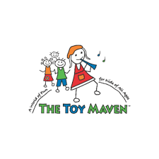
Introduction

Slide 3
The Maven Toys Supply Chain Analysis
Maven Toys is a fun and creative toy company that goes beyond regular play. As a top player in the toy industry, their goal is to create special moments for kids. Now, they’re using data analysis to bring even more joy to families.
In this project, we assume the Power BI Data Analyst role for the Maven Toys Supply Chain.
This project analyzes the cost structure and pricing efficiency across product categories. The goal is to identify areas for cost optimization, ensure pricing strategies align with procurement costs, and support decision-making in supply chain operations.

Slide 4
Supply Chain Analysis Plan

Slide 5
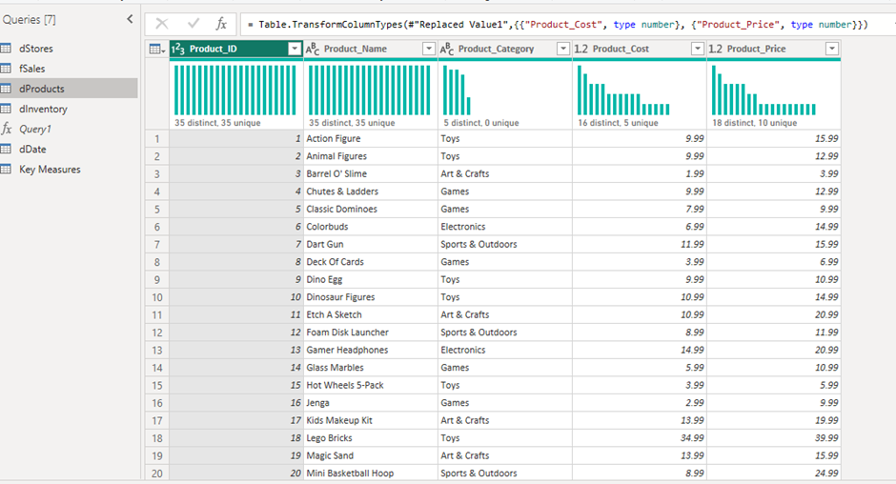
Supply Chain Analysis – Data Cleaning
There were no missing values or duplicates found.
Data types were validated and corrected where necessary.
Removed the $ to avoid clutter when starting the visualization

Slide 6
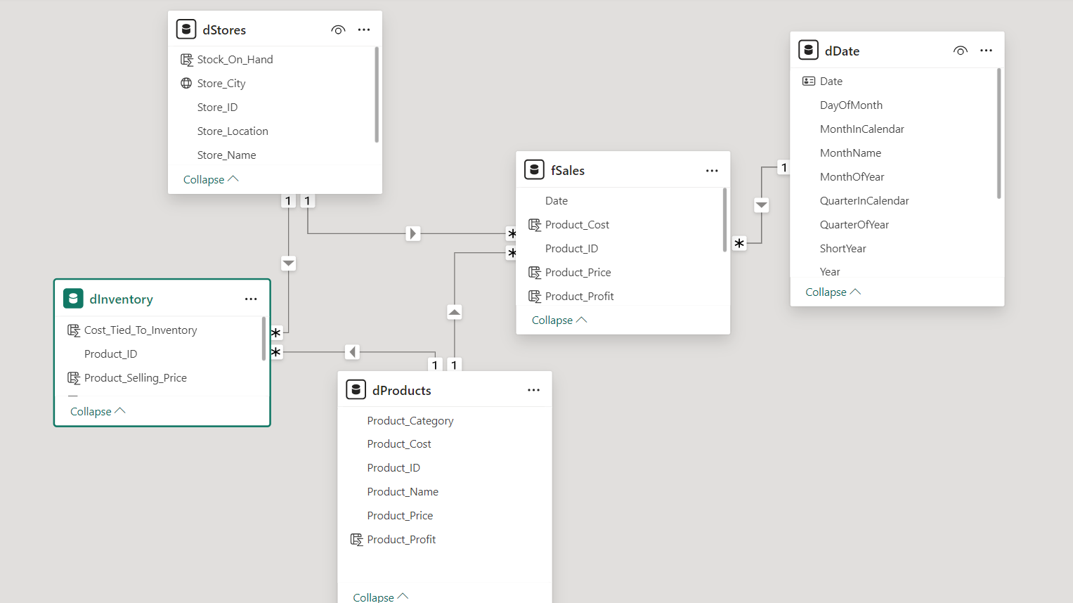
Supply Chain Analysis – Data Modeling
Used a Snowflake Schema

Slide 7
Project KPIs

Slide 8
Supply Chain Analysis - KPIs
Amount Lost in Sales
Description
Measures total revenue lost due to stockouts (products with zero stock on hand).
Purpose
To assess the financial impact of stock shortages and improve inventory management.
Top 10 Expensive Products Sold
Description
Tracks the total units sold for the top 10 most expensive products.
Purpose
To analyze the performance of high-value products and optimize pricing strategies.
Product Cost
Description
Total cost of products sold
Purpose
To monitor cost efficiency and ensure pricing strategies align with product costs.

Slide 9
Supply Chain Analysis – KPIs (Continued)
Product Sales
Description
Total revenue generated from product sales.
Purpose
To evaluate overall sales performance and identify revenue-generating products.
Product Profit
Description
Total profit earned from product sales.
Purpose
To assess profitability across different products and guide strategic decisions.
Product Ranking
Description
Ranking of products based on total sales value.
Purpose
To identify top-performing products and focus on high-demand items.
Total Units Sold
Description
Total number of units sold across all products
Purpose
To gauge overall sales volume and track product demand trends.

Slide 10
Supply Chain Analysis Detailed

Slide 11
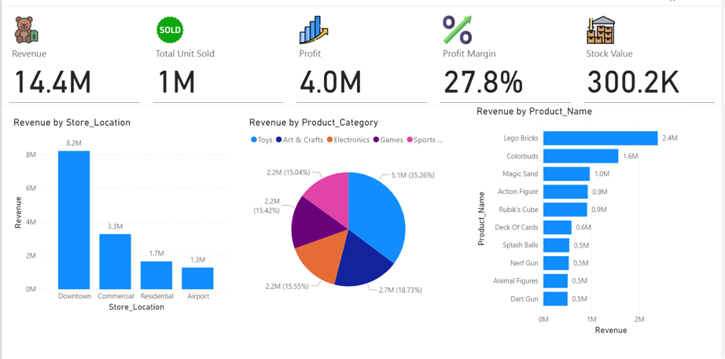
The Downtown store achieved the highest revenue with 8.2M$
Supply Chain Analysis – Revenue Overview
The Maven Toys reached the highest revenue in the category “Toys” with approx. 5.1M$ representing 35.2% of the total supply chain revenue
The highest Toy in revenue is “Logo Bricks” while “Dart Gun’ Scored the lowest in revenue.

Slide 12
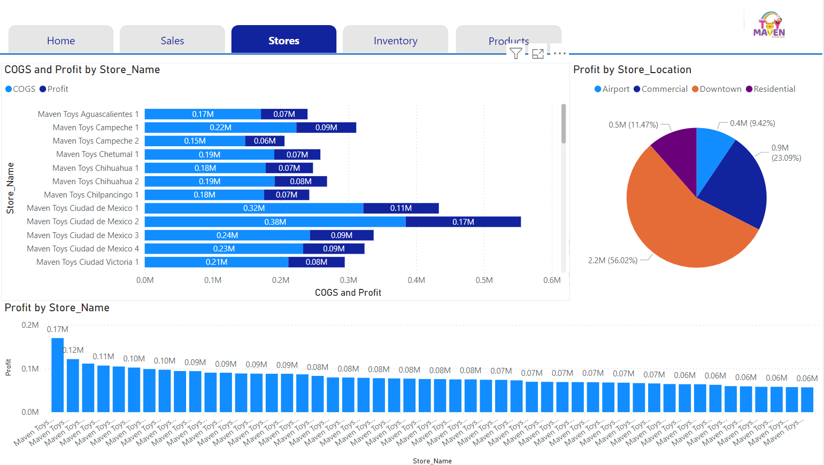
While the Cuidad de Mexico 2 store achieved the highest profit of 0.17M$, it still shows a very high cost at 0.38M$
Supply Chain Analysis – Stores Profit
The Maven Toys stores located Downtown have the highest profit with 2.2M$ representing approximately 56% of the total supply chain profit.
The Graphs show a clear gap between cost and profit.

Slide 13
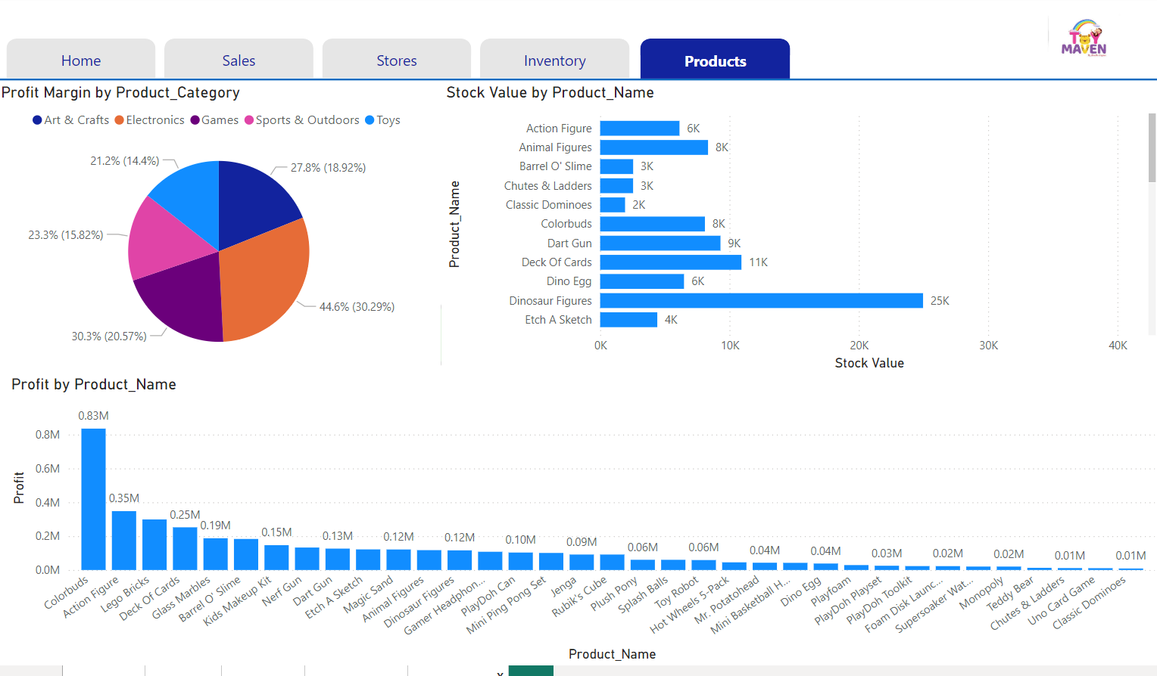
The Electronics category has the highest profit margin of 44.6%, while the Toys category has the lowest with a profit margin of 21.2%
Supply Chain Analysis – Products Profit
The product with the largest stock is “Lego Bricks” with a value of 39K while its total profit comes as 0.3M$
The product with the highest profit is Colorbuds with 0.83M$ in total while having one of the lowest stock values of 8K

Slide 14
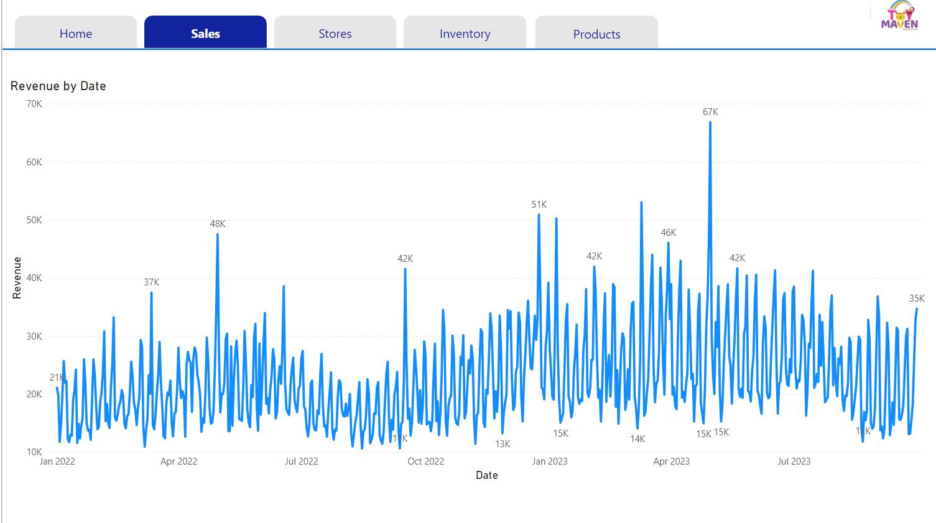
The Maven Toys supply chain achieved its highest revenue at the end of April 2023
Supply Chain Analysis – Sales Revenue
The 2nd highest revenue appears to show in the last week of December 2022 and the 1st week of January 2023.
There is a significant increase in Revenue in the 2nd week of March and the end of April in both 2022 and 2023.

Slide 15
Findings

Slide 16
The product category with the highest profit is “Toys.” This is not the same across store locations; in the areas of “Commercial” and “Airport,” the “Electronics” category has the highest profit.
The sales show a significant increase in the time End of April, assuming Easter, and at the end of December, assuming Christmas.
Sales are being lost due to out-of-stock products at different locations. The highest is the Downtown location, with 565 sales, and the lowest is the Airport location, with 27 sales lost.

Slide 17
Recommendations

Slide 18
Maven Toys supply chain needs to work on decreasing the cost value.
Adjustment is needed in the product in inventory to match demand.
Increase inventory for the product Colorbuds in the Electronics Category as it has the highest profit and a significantly low inventory.
Although “Gamer Headphone” and “ Toy Robot” belong to the Electronics category and contribute the highest profit, they must not be restocked as they are products in high stock with significantly low profit.
Stop restocking the products “Magic Sand” and "Dinosaur Figures” as they are the 2nd and 3rd largest inventory and below the top ten in profit with a significant margin.
Work on lowering the cost of the product “Lego Bricks” as it is; although it achieves the highest revenue, it comes third in profit.

Slide 19
Questions?

Slide 20
Thank You

